Slide 1
Trees

Slide 2
Reading
zyBook:
Chapter 8.1-8.4
Chapter 9.1-9.2

Slide 3
Trees in Computer Science
Data model to represent hierarchical or nested structures
family trees
charts
arithmetic expressions
files and folders

Slide 4
Tree Terminology: Arboreal
n1 is called the root node
n3, n4, n5, and n6 are leaves, since they do not have any children
Nodes which are not leaves are internal nodes
The root is always internal
n2 is the root of a sub-tree T
n1
n2
n3
n4
n5
n6

Slide 5
Tree Terminology: Familiar
n1 is a parent of n2 and n3
n2 and n3 are children of n1
n4, n5, n6 are children of n2
n4, n5, and n6 are siblings
n2, n3, n4, n5, and n6 are descendants of n1
n1 and n2 are ancestors of n5
n1
n2
n3
n4
n5
n6

Slide 6
Conditions for a Rooted Tree
It has a root
All nodes have a unique parent
Following parents from any node in the tree, we eventually reach the root
No cycles!

Slide 7
Rooted vs Free
Root
n1
n6
n1
n3
n2
n2
n3
n4
n5
n6
n5
n4
Rooted Tree
Free Tree

Slide 8
Tree Properties
Paths
Tree Height
Node Depth
Node Degree
Binary Trees
Full Binary Trees
Complete Binary Trees
Perfect Binary Trees

Slide 9
Path
A path through a tree is a listing of nodes from m₁, m_{2,}…to m_{k} such that m₁ is a parent of m₂, m₂ is a parent of m₃, etc…
The length of a path is k-1
A path with k=1 only contains a single node, and the length of the path is 0

Slide 10
Height and Depth of a Tree
n1
The height of the tree is the length of the longest path between any node and the root.
The depth (level) of a node is the length of the path to the root.
0
n2
n3
1
n4
n5
n6
2
n7
n8
3
3

Slide 11
Degree of a Node
The degree of a node is the number of children that node has
Degree of n1
0
Degree of n1
1
Degree of n1
2
n1
n1
n1
n2
n2
n3

Slide 12
Binary Trees
Binary trees can have at most 2 children. Examples:
We distinguish between the left and the right child. The distinction between them is important for tree operations (insert, search, delete, sort)!
n1
n1
n1
n1
n2
n3
n2
n3

Slide 13
Full Binary Tree
Every node has either 0 or 2 children.
n1
n1
n2
n3
n2
n3
n4
n5
n4
Full
Not Full

Slide 14
Complete Binary Tree
All levels must have the maximum number of nodes, except the last level. The last level must be filled from left to right.
n1
n1
n2
n3
n2
n3
n4
n5
Complete
Not Complete

Slide 15
Perfect Binary Tree
All levels must have the maximum number of nodes
n1
n2
n3
n4
n5
n6
n7
Perfect

Slide 16
Tree Traversals
Recursion
Inorder Traversal
Preorder Traversal
Postorder Traversal
Level Order Traversal

Slide 17
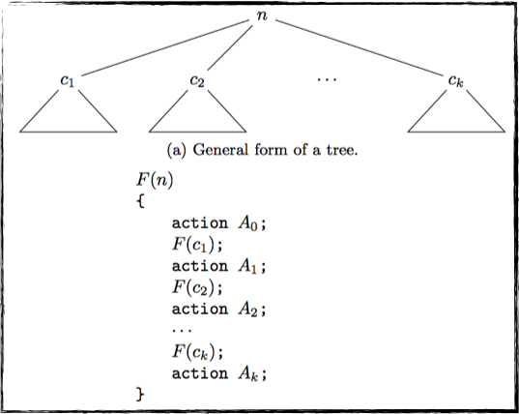
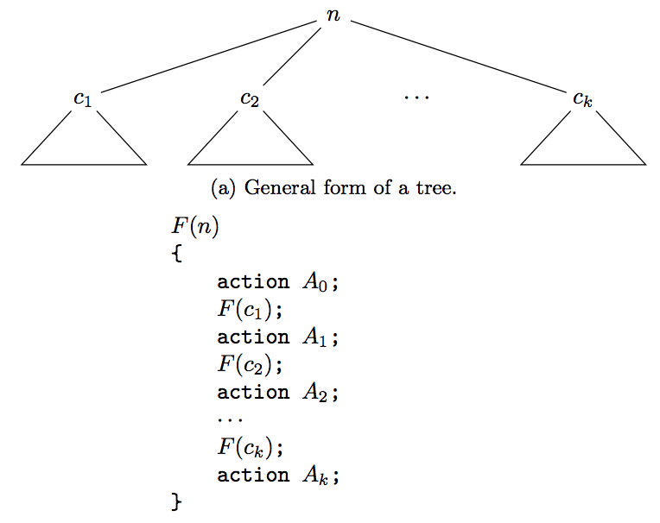
Recursion on Trees
Recursion is “natural” on trees, since trees are recursively defined.

Slide 18
Order of Recursion
1, 11, 13
2, 4, 10
12
3
5, 7, 9
6
8

Slide 19
Tree Traversal: Preorder
List a node the first time it is visited, assuming left child preference
n1, n2, n4, n5, n6, n7, n3
n1
n2
n3
n4
n5
n6
n7

Slide 20
Tree Traversal: Postorder
List a node the last time it is visited, assuming left child preference
n4, n6, n7, n5, n2, n3, n1
n1
n2
n3
n4
n5
n6
n7

Slide 21
Tree Traversal: Inorder
List a node after its left child has been listed and before its right child has been listed, assuming left child preference
n4, n2, n6, n5, n7, n1, n3
n1
n2
n3
n4
n5
n6
n7

Slide 22
Tree Traversal: Level Order
List each node left-to-right, starting at the top level, assuming left child preference
n1, n2, n3, n4, n5, n6, n7
n1
n2
n3
n4
n5
n6
n7

